Slide 1
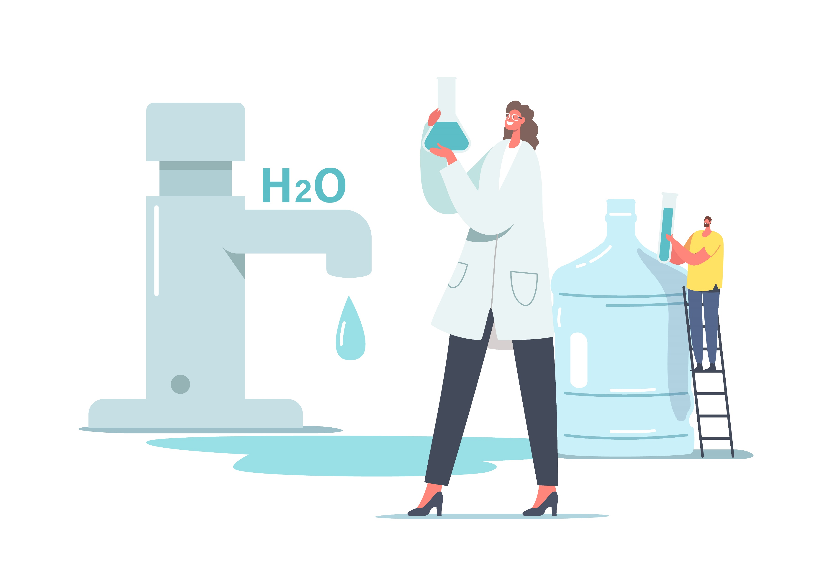
P-188- GROUP-4
PRESENTING
WATER POTABILITY
MENTOR – SAURABH SINGH

Slide 2

TEAM MEMBERS
Hanumandas T.
Shital Auti
Rahul Kakar
Pooja Midage
Mandara T.
Prayag Bhoir

Slide 3
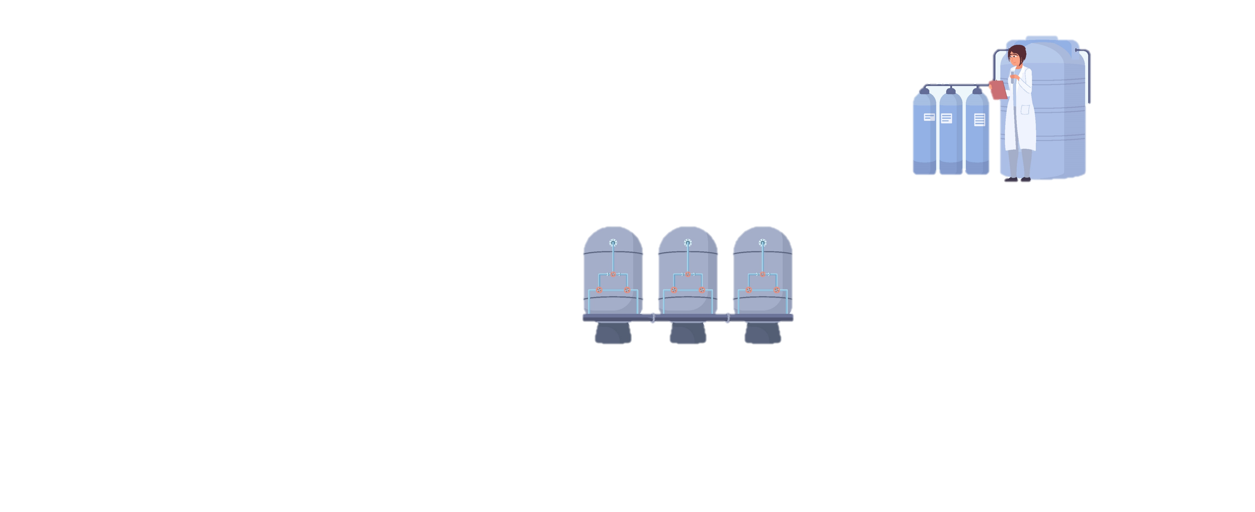
Business Objective
Data provided is related to Water Potability. The objective is to understand the underlying structure in your dataset and come up with a suitable Objective is to create a Machine learning which can help comes Water Potability.
To determine the potability of water by analyzing its physical and chemical properties and ensuring it meets standard drinking water quality guidelines.

Slide 4
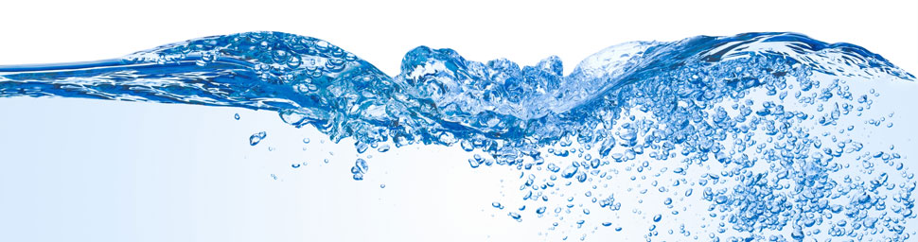
WHAT IS WATER POTABILITY

Slide 5
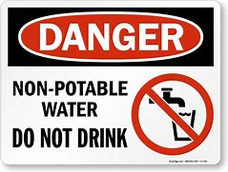
TYPES OF WATER POTABILITY :-
There Are two Types of water Potability
NON-POTABLE WATER.
POTABLE WATER.
NON-PATABLE WATER
Any water that has not been treated or tested.
Non-potable water should never be used to wash food or food ingredients.

Slide 6
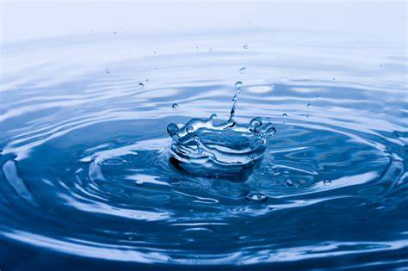
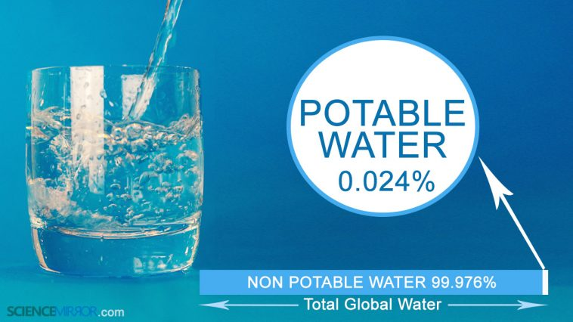
PORTABLE WATER
water that is safe to drink or use for food preparation.
It is filtered and treated properly and is finally free from all the contaminants and harmful bacteria.
Purification of water can be done by various processes like using UV filtered water purifier, reverse osmosis, etc.
PH is an important parameter in evaluating the acid–base balance of water.

Slide 7

Project Architecture / Project Flow
Model deployment
Understanding business problem
Collection of data
Cleaning of data
Exploratory data analysis
Model building

Slide 8

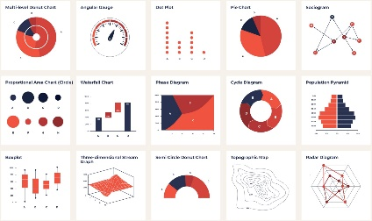
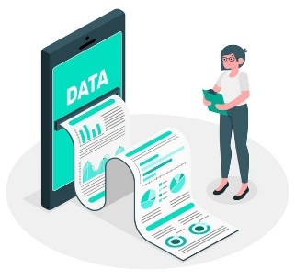
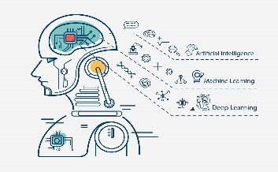
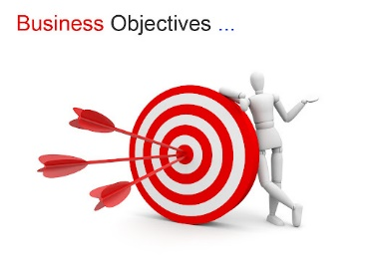
Work Flow Of Our Project
Objective of Business
Data Preprocessing
E.D.A
Data Collection
Model Building/ Evaluation
Model Deployment

Slide 9


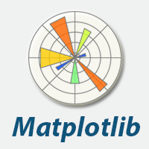



Tools which are Used :

Slide 10
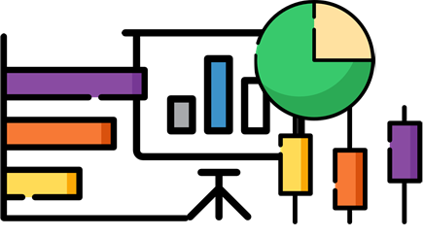


Exploratory Data Analysis (EDA)

Slide 11
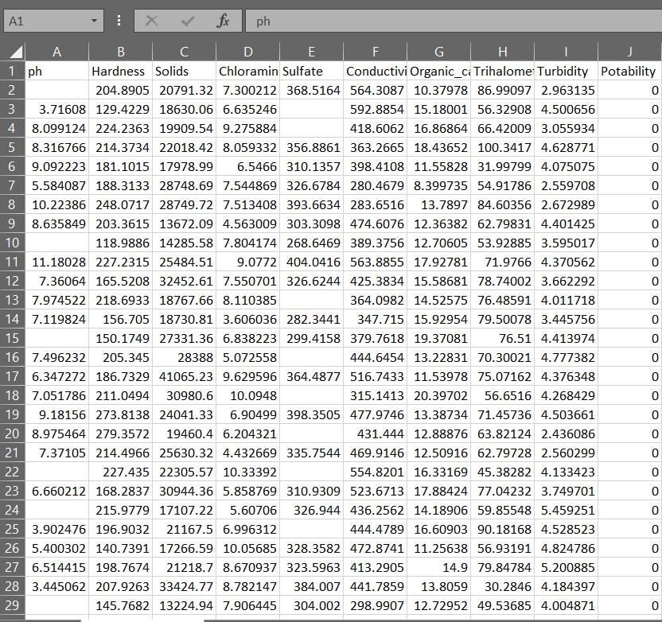
DATASET DETAILS
DATASET
3276 ROWS & 10 COLUMNS

Slide 12
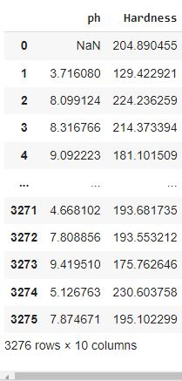
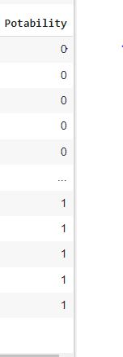
DATA
Here is data of PH value for water is safe for Human Consumption where 1 means potable and 0 means Not Potable.

Slide 13
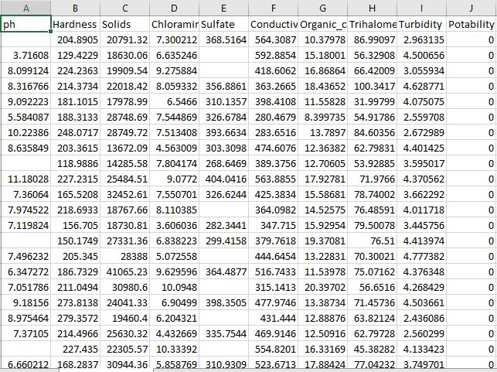
First, we upload the data.
After that we just do some basic analysis about data like shape of data, is there null values or not, correlation between the data and outlier detection.
Then we plot our data in different visualization to understand the data.
DATASET
3276 Rows & 10 Columns
DATA TYPES
Ph, Hardness , Solids , Chloramines , Sulphate ;
Conductivity , Organic carbon , Trihalomethanes ,
Turbidity and Potability

Slide 14
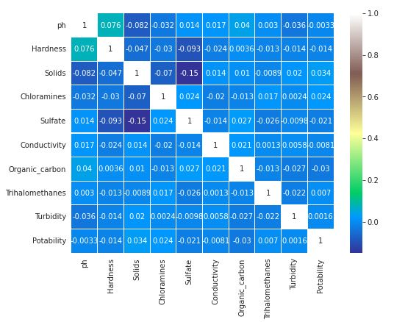
Information on Data
Physical properties: temperature, color, turbidity, odor, and taste
Chemical properties: pH, total dissolved solids (TDS), total hardness, nitrates, chlorine levels, and heavy metal content
Biological properties: presence of bacteria, viruses, and parasites
Compliance with drinking water standards set by regulatory agencies such as the Environmental Protection Agency (EPA) or World Health Organization (WHO).

Slide 15
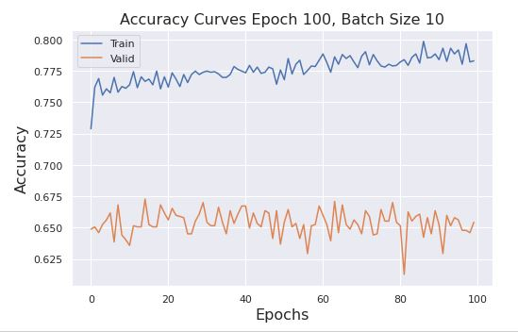
Potability Accuracy Analysis
Accuracy analysis helps ensure the quality and reliability of water potability data and helps identify potential sources of error or bias in the testing process.

Slide 16
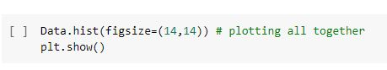
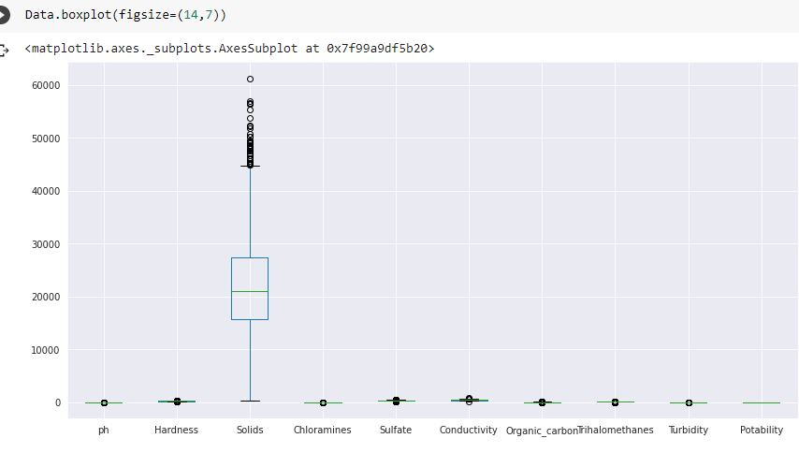
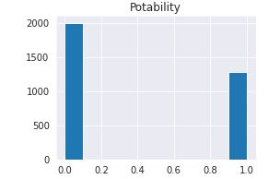
Histogram / Box- plot
There is Outliers present in data

Slide 17



MODEL BUILDING

Slide 18
Model Building method which were used are
Using Logistic Regression
Train decision tree classifier and checking accuracy
Using Random Forest
XGBoost Classifier
KNeighbours
SVM (Support Vector Machine)
AdaBoost Classifier

Slide 19
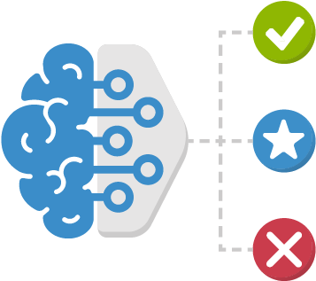
Model Evaluation
Method | Accuracy
Using Logistic Regression | 64%
Train decision tree classifier and checking accuracy | 60%
Using Random Forest | 63%
XGBoost Classifier | 67%
KNeighbours | 67%
SVM (Support Vector Machine) | 69%
AdaBoost Classifier | 63%
Note :- SVM have good Accuracy and it is almost reach 69%

Slide 20
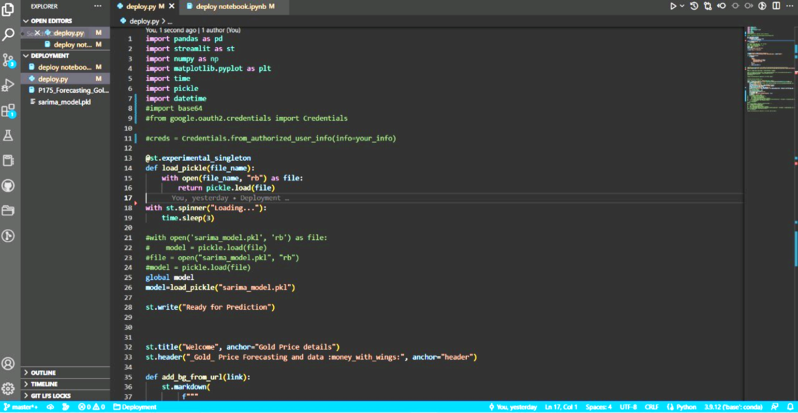
Model Deployment

Slide 21
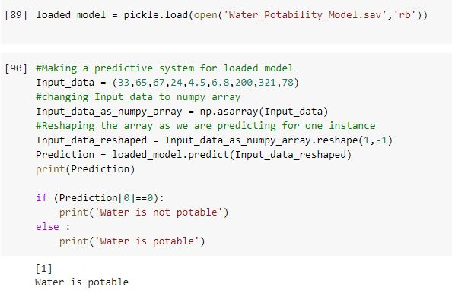
Final Output

Slide 22


